Slide 1

Different ways to
speed up computer systems
Keivan Navi
Winter 2025

Slide 2
Outline
Pipeline
Super-Pipeline
Super-Scalar
1/30
Keivan Navi
knavi@cpp.edu

Slide 3
General Performance Metrics
Performance can be determined by:
Instruction Count
Clock Rate
CPI (Clocks Per Instructions)
Execution Time = Instruction Count * CPI * Cycle Time
The Instruction Count is governed by Compiler’s Techniques and Architectural decisions.
The CPI is primarily governed by Architectural decisions.
The Cycle Time is governed by technology improvements and Architectural decisions.
2/30
Keivan Navi
knavi@cpp.edu

Slide 4
Unpipelined Processor
Only ONE instruction can be resident at the processor at any given time.
The whole processor is considered as ONE stage, k=1. CPI = 1 / IPC
One Instruction
resident in Processor
The number of stages
,
K
=
1
3/30
Keivan Navi
knavi@cpp.edu

Slide 5
First method: Pipelining
4/30
Keivan Navi
knavi@cpp.edu

Slide 6
Pipelining
Pipelining is a key implementation technique used to build fast processors.
It allows the execution of multiple instructions to overlap in time.
The throughput of an instruction pipeline is the measure of how often an instruction exits the pipeline.
So :
Pipelining is a way of speeding up execution of instructions by overlapping the execution of multiple instructions.
5/30
Keivan Navi
knavi@cpp.edu

Slide 7
Pipelining
Pipelining increases throughput, but not latency.
Limitations:
Computations must be divisible into stage size
Pipeline registers add overhead
6/30
Keivan Navi
knavi@cpp.edu

Slide 8
Pipelining Processors
Two possible implementations of the MIPS architecture:
Single-cycle datapath (It executes each instruction in just one clock cycle, but the cycle time may be very long.)
Multicycle datapath (It has much shorter cycle times, but each instruction requires many cycles to be executed.)
Pipelining gives the best of both worlds and is used in almost every modern processor.
Cycle times are short so clock rates are high.
But we can still execute an instruction in about one clockcycle!
Single Cycle Datapath | CPI = 1 | Long Cycle Time
Multi-cycle Datapath | CPI = ~4 | Short Cycle Time
Pipelined Datapath | CPI = ~1 | Short Cycle Time
7/30
Keivan Navi
knavi@cpp.edu

Slide 9
Pipelining Processors
Executing a MIPS instruction can take up to five steps:
However not all instructions need all five steps.
Step | Name | Description
Instruction Fetch | IF | Read an instruction from memory.
Instruction Decode | ID | Read source registers and generate control signals.
Execute | EX | Compute an R-type result or a branch outcome.
Memory | MEM | Read or write the data memory.
Writeback | WB | Store a result in the destination register.
Instruction | Steps required
beq | IF | ID | EX
R-type | IF | ID | EX |  | WB
sw | IF | ID | EX | MEM
lw | IF | ID | EX | MEM | WB
8/30
Keivan Navi
knavi@cpp.edu

Slide 10
Types of Instructions
There are 3 different types of instructions:
1- Register Type (R-Type):
2-Laod Store:
3-Branch:
8.5/30

Slide 11
Single-cycle datapath diagram
0
M
u
x
1
Add
PC
4
Add
Shift
left 2
PCSrc
RegWrite
Read
address
Instruction
[31-0]
I [9 - 5]
MemWrite
MemToReg
Read
register 1
Read
data 1
I [4 - 0]
ALU
Read
address
Read
data
1
M
u
x
0
Instruction
memory
Write
register
Zero
0
M
u
x
1
Read
data 2
0
M
u
x
1
Result
Write
address
Read
register 2
Write
data
Data
memory
I [20 - 16]
Write
data
Registers
ALUOp
ALUSrc
MemRead
RegDst
I [31 - 0]
Sign
extend
How long does it take to execute each instruction?
9/30
Keivan Navi
knavi@cpp.edu

Slide 12
Pipelining
We shouldn’t have to wait for the entire instruction to complete before we can reuse the functional units. For example, the instruction memory is free in the Instruction Decode step as shown below, so...
Idle
Instruction Decode (ID)
RegWrite
Read
address
Instruction
[31-0]
I [9 - 5]
MemWrite
MemToReg
Read
register 1
Read
data 1
I [4 - 0]
ALU
Read
address
Read
data
1
M
u
x
0
Instruction
memory
Write
register
Zero
0
M
u
x
1
Read
data 2
0
M
u
x
1
Result
Write
address
Read
register 2
Write
data
Data
memory
I [20 - 16]
Write
data
Registers
ALUOp
ALUSrc
MemRead
RegDst
I [31 - 0]
Sign
extend
10/30
Keivan Navi
knavi@cpp.edu

Slide 13
Decoding and fetching together
Why don’t we go ahead and fetch the next instruction while we’re decoding the first one?
Fetch 2nd
Decode 1st instruction
RegWrite
Read
address
Instruction
[31-0]
I [9 - 5]
MemWrite
MemToReg
Read
register 1
Read
data 1
I [4 - 0]
ALU
Read
address
Read
data
1
M
u
x
0
Instruction
memory
Write
register
Zero
0
M
u
x
1
Read
data 2
0
M
u
x
1
Result
Write
address
Read
register 2
Write
data
Data
memory
I [20 - 16]
Write
data
Registers
ALUOp
ALUSrc
MemRead
RegDst
I [31 - 0]
Sign
extend
11/30
Keivan Navi
knavi@cpp.edu

Slide 14
Executing, decoding and fetching
Similarly, once the first instruction enters its Execute stage, we can go ahead and decode the second instruction. But now the instruction memory is free again, so we can fetch the third instruction!
Fetch 3rd
Decode 2nd
Execute 1st
RegWrite
Read
address
Instruction
[31-0]
I [9 - 5]
MemWrite
MemToReg
Read
register 1
Read
data 1
I [4 - 0]
ALU
Read
address
Read
data
1
M
u
x
0
Instruction
memory
Write
register
Zero
0
M
u
x
1
Read
data 2
0
M
u
x
1
Result
Write
address
Read
register 2
Write
data
Data
memory
I [20 - 16]
Write
data
Registers
ALUOp
ALUSrc
MemRead
RegDst
I [31 - 0]
Sign
extend
12/30
Keivan Navi
knavi@cpp.edu

Slide 15
Making Pipelining Work
We’ll make our pipeline 5 stages long, to handle load instructions as they were handled in the multi-cycle implementation.
Stages are: IF, ID, EX, MEM, and WB
We want to support executing 5 instructions simultaneously: one in each stage.
13/30
Keivan Navi
knavi@cpp.edu

Slide 16
Pipeline terminology
 | Clock cycle
 | 1 | 2 | 3 | 4 | 5 | 6 | 7 | 8 | 9
lw $t0, 4($sp) | IF | ID | EX | MEM | WB
sub $v0, $a0, $a1 |  | IF | ID | EX | MEM | WB
and $t1, $t2, $t3 |  |  | IF | ID | EX | MEM | WB
or $s0, $s1, $s2 |  |  |  | IF | ID | EX | MEM | WB
add $sp, $sp, -4 |  |  |  |  | IF | ID | EX | MEM | WB
filling
full
emptying
The pipeline depth is the number of stages—in this case, five.
In the first four cycles here, the pipeline is filling, since there are unused functional units.
In cycle 5, the pipeline is full. Five instructions are being executed simultaneously, so all hardware units are in use.
In cycles 6-9, the pipeline is emptying.
14/30
Keivan Navi
knavi@cpp.edu

Slide 17
Pipeline terminology
 | Clock cycle
 | 1 | 2 | 3 | 4 | 5 | 6 | 7 | 8 | 9
lw $t0, 4($sp) | IF | ID | EX | MEM | WB
lw $t1, 8($sp) |  | IF | ID | EX | MEM | WB
lw $t2, 12($sp) |  |  | IF | ID | EX | MEM | WB
lw $t3, 16($sp) |  |  |  | IF | ID | EX | MEM | WB
lw $t4, 20($sp) |  |  |  |  | IF | ID | EX | MEM | WB
filling
Execution time on ideal pipeline:
time to fill the pipeline + one cycle per instruction
What is the execution time for N instructions?
Compare with other implementations:
Single Cycle: (8ns clock period)
How much faster is pipelining for N=1000 ?
15/30
Keivan Navi
knavi@cpp.edu

Slide 18
Important Observation
Each functional unit can only be used once per instruction.
Each functional unit must be used at the same stage for all instructions. See the problem if:
Load uses Register File’s Write Port during its 5th stage
R-type uses Register File’s Write Port during its 4th stage
 | Clock cycle
 | 1 | 2 | 3 | 4 | 5 | 6 | 7 | 8 | 9
add $sp, $sp, -4 | IF | ID | EX | WB
sub $v0, $a0, $a1 |  | IF | ID | EX | WB
lw $t0, 4($sp) |  |  | IF | ID | EX | MEM | WB
or $s0, $s1, $s2 |  |  |  | IF | ID | EX | WB
lw $t1, 8($sp) |  |  |  |  | IF | ID | EX | MEM | WB
16/30
Keivan Navi
knavi@cpp.edu

Slide 19
A solution: Insert NOP stages
Enforce uniformity
Make all instructions take 5 cycles.
Make them have the same stages, in the same order
Some stages will do nothing for some instructions
Stores and Branches have NOP stages too…
R-type | IF | ID | EX | NOP | WB
 | Clock cycle
 | 1 | 2 | 3 | 4 | 5 | 6 | 7 | 8 | 9
add $sp, $sp, -4 | IF | ID | EX | NOP | WB
sub $v0, $a0, $a1 |  | IF | ID | EX | NOP | WB
lw $t0, 4($sp) |  |  | IF | ID | EX | MEM | WB
or $s0, $s1, $s2 |  |  |  | IF | ID | EX | NOP | WB
lw $t1, 8($sp) |  |  |  |  | IF | ID | EX | MEM | WB
store | IF | ID | EX | MEM | NOP
branch | IF | ID | EX | NOP | NOP
17/30
Keivan Navi
knavi@cpp.edu

Slide 20
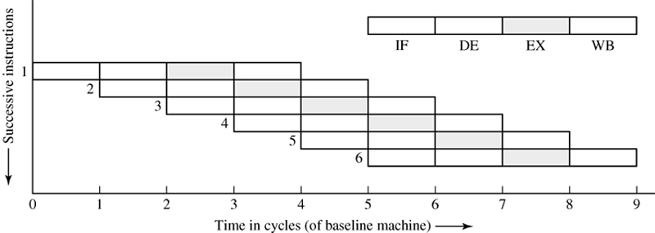
Therefore…
K –number of pipe stages, instructions are resident at the processor at any given time.
In our example, K=5 stages, number of parallelism (concurrent instruction in the processor) is also equal to 5.
One instruction will be accomplished each clock cycle, CPI = IPC = 1
18/30
Keivan Navi
knavi@cpp.edu

Slide 21
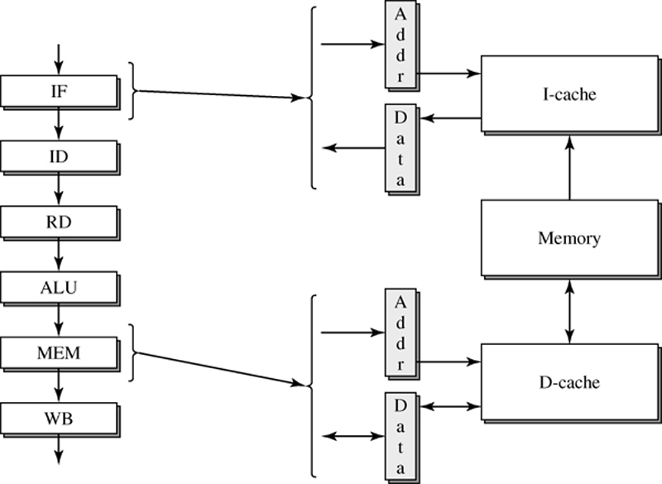
Example of a Six-Stage Pipelined Processor
19/30
Keivan Navi
knavi@cpp.edu

Slide 22
Pipelining & Performance
The Pipeline Depth is the number of stages implemented in the processor, it is an architectural decision, also it is directly related to the technology. In the previous example K=5.
The Stall’s CPI are directly related to the code’s instructions and the density of existing dependences and branches.
Ideally the CPI is ONE.
20/30
Keivan Navi
knavi@cpp.edu

Slide 23
Second method: Super-Pipelining
21/30
Keivan Navi
knavi@cpp.edu

Slide 24
Super-Pipelining Processor
IF (Instruction Fetch) : requires a cache access in order to get the next instruction to be delivered to the pipeline.
ID (Instruction Decode) : requires the control unit to decode the instruction to identifying what it does.
Obviously the fetch stage cache access requires much more time than the decode stage –combinational logic.
We can subdivide each pipe-stage into m other stages of smaller amount of time required for each stage: minor cycle time.
22/30
Keivan Navi
knavi@cpp.edu

Slide 25
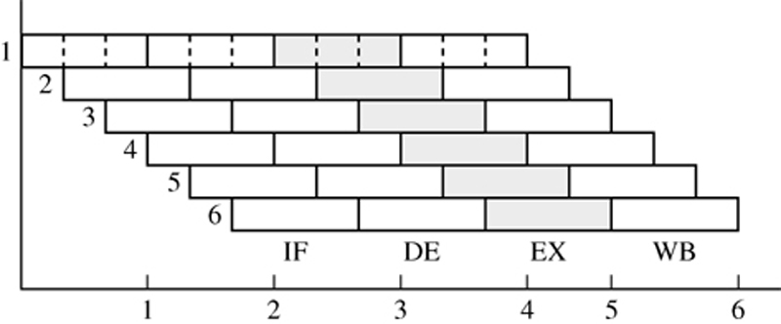
Super-Pipelining Processor
Super-pipelined machine of Degree m=3
The machine can issue a new instruction every minor cycle.
Parallelism = K * m.
For this figure: Parallelism = K * m = 4 * 3 = 12
23/30
Keivan Navi
knavi@cpp.edu

Slide 26
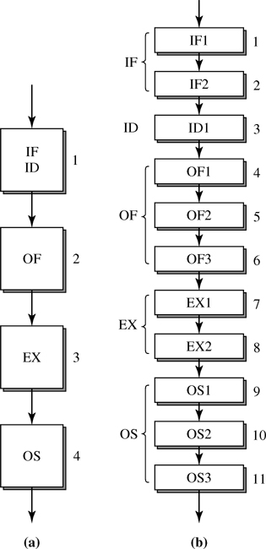
Stage Quantization
(a)four-stage instruction pipeline, (b)eleven-stage instruction pipeline
24/30
Keivan Navi
knavi@cpp.edu

Slide 27
Third method: Superscaling
25/30
Keivan Navi
knavi@cpp.edu

Slide 28
Characteristics of Superscalar Machines
Simultaneously advance multiple instructions through the pipeline stages.
Multiple functional units => higher instruction execution throughput.
Able to execute instructions in an order different from that specified by the original program.
Out of program order execution allows more parallel processing of instructions.
26/30
Keivan Navi
knavi@cpp.edu

Slide 29
Superpipelined Superscalar Machine
The superscalar degree is determined by the issue parallelism n, the sub-stages m and the number of stages k.
Parallelism = K * m * n
For this figure: Parallelism = K * m * n = 5 * 3 * 3 = 45
27/30
Keivan Navi
knavi@cpp.edu

Slide 30
Deeper Pipeline, a Solution?
As mentioned before, the performance is proportional to Instruction Count, Clock Rate and IPC.
Deeper pipeline has fewer logic gate levels in each stage, this leads to a shorter cycle time and higher clock rate.
But deeper pipeline can potentially cause higher penalties for dealing with inter-instruction dependences.
28/30
Keivan Navi
knavi@cpp.edu

Slide 31
Bounded Pipelines Performance
Scalar pipeline can only initiate at most one instruction every cycle, hence IPC is fundamentally bounded by ONE.
To get more instruction throughput, we must initiate more than one instruction every machine cycle.
Hence, having more than one instruction resident in each pipeline stage is necessary: parallel pipeline.
29/30
Keivan Navi
knavi@cpp.edu

Slide 32
From Scalar to Superscalar Pipelines
Superscalar pipelines are parallel pipelines: able to initiate the processing of multiple instructions in every machine cycle.
Superscalars are diversified; they employ multiple and heterogeneous functional units in their execution stages.
They are implemented as dynamic pipelines in order to achieve the best possible performance without requiring reordering of instructions by the compiler.
30/30
Keivan Navi
knavi@cpp.edu

Slide 33
Acknowledgement
I would like to thank my dear PhD student Samaneh Firouzi for her help, enthusiasm and support for designing this power point.

